Slide 1
CONTENTS
Introducing Hadoop
Need of Hadoop
Limitations of RDBMS
RDBMS versus Hadoop
Distributed Computing Challenges
History of Hadoop
Hadoop Overview

Slide 2
CONTENTS
Use Case of Hadoop
Hadoop Distributors
HDFS (Hadoop Distributed File System)
Processing Data with Hadoop
Managing Resources and Applications with Hadoop YARN (Yet another Resource Negotiator)
Interacting with Hadoop Ecosystem

Slide 3
INTRODUCING HADOOP
Big Data
Extremely large datasets that are hard to deal with using relational databases
Storage/cost
Search/performance
Analytics and Visualization
Need for parallel processing on hundreds of machines
ETL can not complete with in a reasonable time
Beyond 24hrs-never catch up

Slide 4





BIG DATA EVERY WHERE!
Lots of data is being collected and warehoused
Web data, e-commerce
purchases at department/ grocery stores
Bank/Credit Card transactions
Social Network

Slide 5
HOW MUCH DATA?
Every Day
NYSE(New York Stock Exchange) generates 1.5 billion shares and trade data
Face book stores 2.7 billion comments and Likes
Google processes about 24 peta bytes of data
Every Minute
Face book users shares nearly 2.5 million pieces of content
Twitter users tweet nearly 300,000times
Instagram users post nearly 220,000 new photos
Youtube users upload 72 hours of new video content
Apple users download nearly 50,000 apps
Email users send over 200 million messages
Amazon generates over $80,000 in online sales
Google receives over 4million search queries
Every second
Banking applications process more than 10,000 credit card transactions

Slide 6
DATA: THE TREASURE TROVE
Provides business advantages such as
Generating product recommendations
Inventing new products
Analyzing the market
Provides few early key indicators that can turn the fortune of business
Provides room for precise analysis. If we have more data for analysis then we have greater precision of analysis

Slide 7
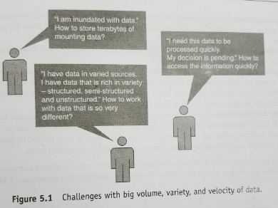

Slide 8
WHY HADOOP
Its capability to handle massive amounts of data, different categories of data – fairly quickly.
Low Cost: Hadoop is an open-source framework and uses commodity hardware to store enormous quantities of data.

Slide 9
KEY CONSIDERATIONS OF HADOOP
Inherent data protection
Storage flexibility
Low Cost
Why Hadoop?
Scalability
Computing power

Slide 10
Computing Power: Hadoop is based on distributed computing model which processes very large volumes of data fairly-quickly. The more the number of computing nodes, the more the processing power at hand.
Scalability: Simply adding more nodes as the system grows and requires much less administration.
Storage flexibility: It allows to store any varieties of data.
Inherent data protection: Hadoop protects data and executing applications against hardware failure. If a node fails, it automatically redirects the jobs that had been assigned to this node to the other functional and available nodes and ensures that distributed computing does not fail. It stores multiple copies.

Slide 11
LIMITATIONS OF RDBMS
RDBMS is not suitable for storing and processing large files, images, videos
RDBMS is not good choice when it comes to advanced analytics involving machine learning

Slide 12
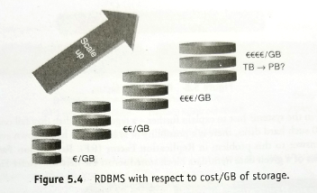

Slide 13
DISTRIBUTED COMPUTING CHALLENGES
Resource Sharing- access any data and utilize CPU across the system
Heterogeneity-different OS and hardware
Concurrency-allow concurrent access, update of shared resources
Hardware Failure
How to process gigantic store of data

Slide 14
HISTORY OF HADOOP
Open source software framework designed for storage and processing of large scale data on clusters of commodity hardware.
Created by Doug Cutting and Mike Carafella in 2005.
Cutting named the program after his son’s toy elephant.

Slide 15
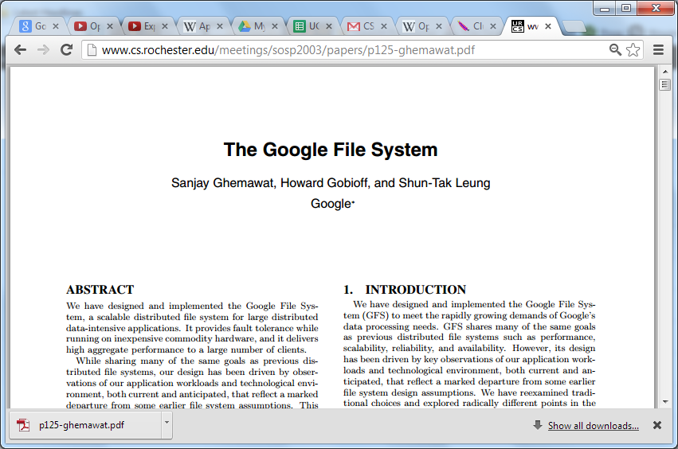

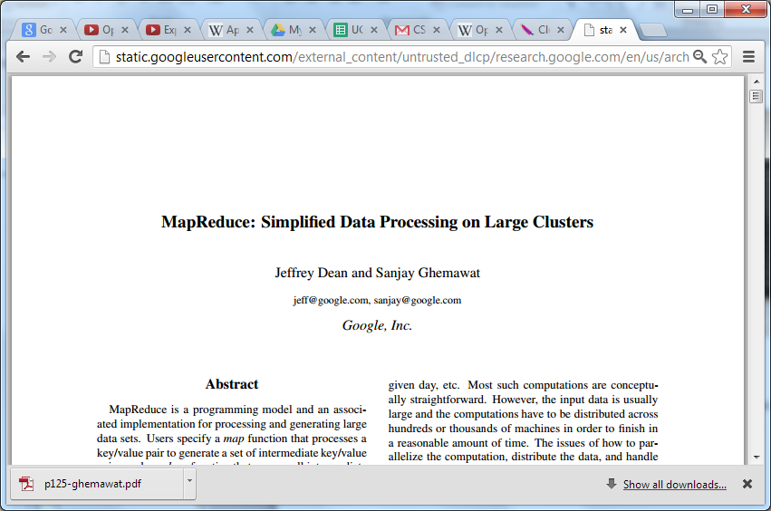


GOOGLE ORIGINS
2003
2004

Slide 16




HADOOP’S DEVELOPERS
2005: Doug Cutting and Michael J. Cafarella developed Hadoop to support distribution for the Nutch search engine project.
The project was funded by Yahoo.
2006: Yahoo gave the project to Apache
Software Foundation.
Doug Cutting

Slide 17
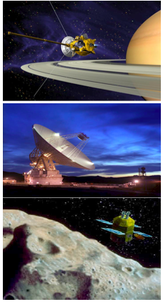
REAL WORLD APPLICATION OF NUTCH
NASA’s Planetary Data System
NASA’s archive for all planetary science data collected by missions over the past 30 years
Collected 20 TB over the past 30 years
Increasing to over 200 TB in the next 3 years!
Built up a catalog of all data collected

Slide 18
SOME HADOOP MILESTONES
2008 - Hadoop Wins Terabyte Sort Benchmark (sorted 1 terabyte of data in 209 seconds, compared to previous record of 297 seconds)
2009 - Avro and Chukwa became new members of Hadoop Framework family
2010 - Hadoop's Hbase, Hive and Pig subprojects completed, adding more computational power to Hadoop framework
2011 – ZooKeeper(centralized service) Completed
2013 - Hadoop 1.1.2 and Hadoop 2.0.3 alpha.
- Ambari(secure hadoop clusters), Cassandra, Mahout have been added

Slide 19
RDBMS VERSUS HADOOP
RDBMS Hadoop
System Relational DBs node based flat structure
Data structured data structured, unstructured
realtime(xml,json)
Processing OLTP Analytical, big data processing
Choice When the data Does not require
needs consistent
relationship
Processor needs expensive In a hadoop cluster a
hardware or high node require only a processor
end processors to a network card, and
store huge volumes few hard drives
of data
Cost Around $10,000 to $14000 $4000 per tera bytes of Per terabytes of storage storage

Slide 20
HADOOP DISTRIBUTORS
Cloudera - CDH 4.0, CDH 5.0
HortonWorks - HDP 1.0, HDP 2.0
MAPR - M3, M5 and M8
Apache Hadoop - Hadoop 1.0, Hadoop 2.0

Slide 21
HADOOP DISTRIBUTORS
Cloudera – CDH(ClouDera Hadoop), the world's most popular Hadoop distribution (100% open source platform). It includes all the leading Hadoop ecosystem components to
Store
Process
Discover
Model
Serve unlimited data

Slide 22
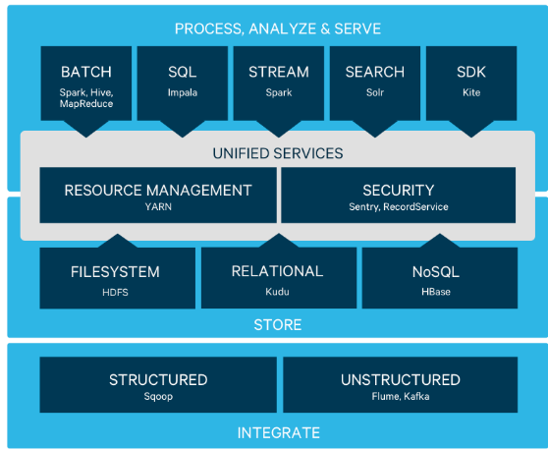

Slide 23
CONTD..,
CDH 4.0-
Availability- High availability namenode, better job isolation, hard drive failure handling, and multi-version support
Utilization – multiple namespaces, co-processors and a slot-less resource management model
Performance – improvements in HBase, HDFS, MapReduce and compression performance
Usability – broader BI support, expanded API access
Security – scheduler ACL(Access Control List)’s
CDH 5.0

Slide 24
CONTD..,
Hortonworks- a big data software company in Santa Clara, California. The company develops and supports Apache Hadoop, for the distributed processing of large data sets across computer clusters.
HDP 1.0
HDP 2.0
MAPR-MapR replaces HDFS component and instead uses its own proprietary file system, called MapRFS. MapRFS helps incorporate enterprise-grade features into Hadoop, enabling more efficient management of data, reliability and most importantly, ease of use
M3
M5
M8
Apache Hadoop
Hadoop 1.0
Hadoop 2.0

Slide 25
CLOUDERA VS HORTONWORKS
Cloudera has announced that its long term goal is to become an enterprise data hub, thus diminishing the need of data warehouse. Hortonworks, on the other hand, remains firmly a provider of Hadoop distro, and has partnered with data warehousing company Teradata.
While Cloudera CDH can be run on windows server, HDP is available as a native component on the windows server. A Windows-based Hadoop cluster can be deployed on Windows Azure through HDInsight Service.
Cloudera has a proprietary management software Cloudera Manager, SQL query handling interface Impala, as well as Cloudera Search for easy and real-time access of products. Hortonworks has no proprietary software, uses Ambari for management and Stinger for handling queries, and Apache Solr for searches of data.
Cloudera has a commercial license, while Hortonworks has open source license. Cloudera also allows the use of its open- source projects free of cost, but the package doesnt include the management suite Cloudera Manager or any other proprietary software.
Cloudera has a free 60-day trial, Hortonworks is completely free.

Slide 26
USE CASES OF HADOOP
ClickStream Data(Mouse Clicks)
Helps to understand the purchasing behavior of a customer
ClickStream analysis helps online marketers to optimize their product web pages, promotional content etc to improve their business
ClickStream Data Analysis using Hadoop-Key benefits
Joins click stream data with CRM and sales data | Stores years of data without much incremental cost | Hive or Pig script to analyze data
ClickStream Data Analysis

Slide 27
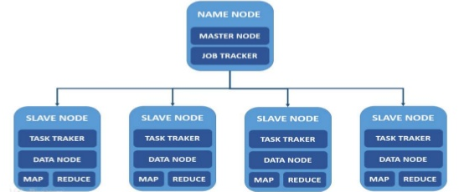
HADOOP ARCHITECTURE

Slide 28
Hadoop Components
Hadoop Ecosystem
FLUME
OOZIE
MAHOUT
……..
HIVE
PIG
SQOOP
HBASE
zzcxzvzvfv
Core Components
Map Reduce Programming
HDFS

Slide 29
HADOOP CORE COMPONENTS
HDFS
Storage component
Distributives data across several nodes
Natively redundant
MapReduce
Computational frame work
Splits a task across multiple nodes
Process data in parallel

Slide 30
HADOOP ECOSYSTEM
Ambari (provisioning, managing and monitoring hadoop cluster)
Sqoop (relational database data collector) | Mahout (machine learning) | Pig (data flow) | R (statistics) | Hive(data warehouse) | Oozie (work flow-manages hadoop jobs)
Flume (Log Data collector) | Mapreduce(distributed processing) |  | Hbase(Distributed table store) |  | Zookeeper(coordinator)
 | HDFS(Hadoop Distributed Five System)

Slide 31
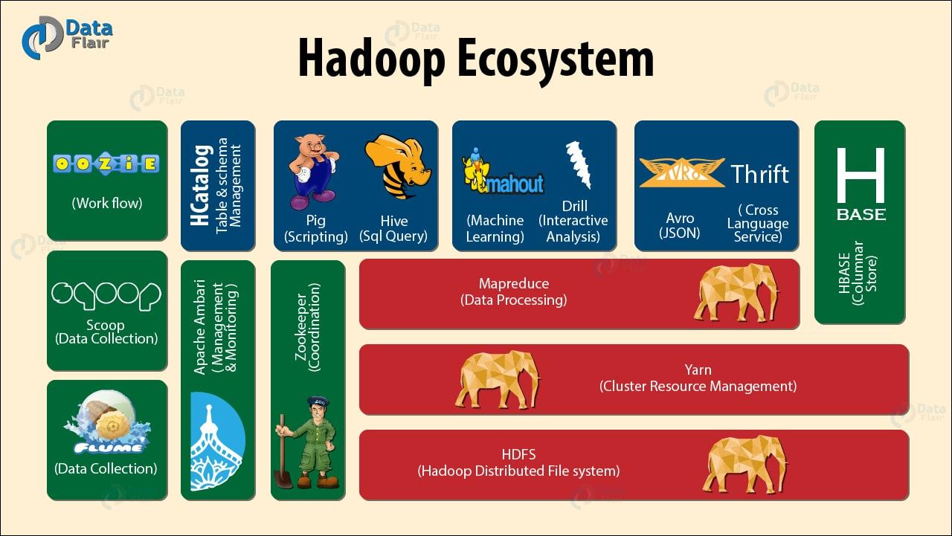

Slide 32
HADOOP DISTRIBUTED FILE SYSTEM
Some key points of HDFS are as follows:
Storage component of hadoop
Distributed file system
Modeled after Google File System
Optimized for high throughput
You can replicate a file for a configured number of times, which is tolerant in terms of both software and hardware.
Re-replicates data blocks automatically on nodes that have failed.

Slide 33
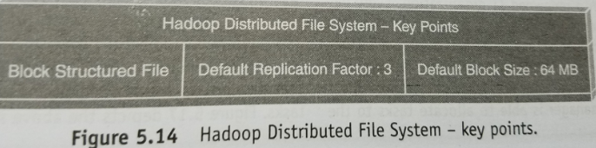

Slide 34
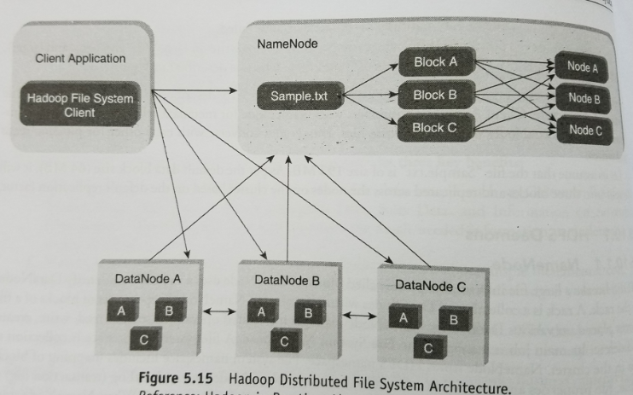

Slide 35
HDFS DAEMONS
NameNode
Blocks
rackID
File System Namespace
FsImage
EditLog

Slide 36
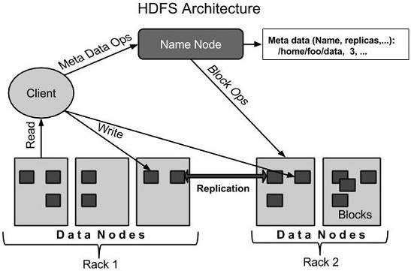

Slide 37
CONTD..,
DataNode
Multiple data nodes per cluster
Sends heartbeat
Secondary name node
Takes snapshot of HDFS meta data at intervals specified in the hadoop configuration
Memory is same for secondary node
But secondary node on different machine
In case of failure secondary name node can be configured manually to bring up the cluster

Slide 38
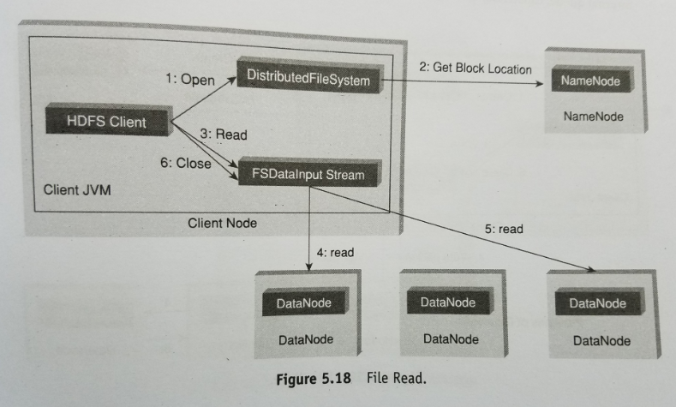
Anatomy of file read

Slide 39
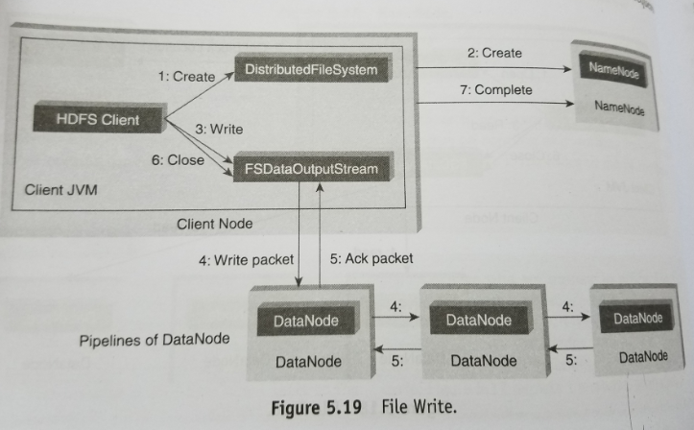
Anatomy of file write

Slide 40
REPLICA PLACEMENT STRATEGY
First replica is placed on the same node
Second replica on a node that is present on different rack
Third replica on the same rack as second but different node in the rack

Slide 41
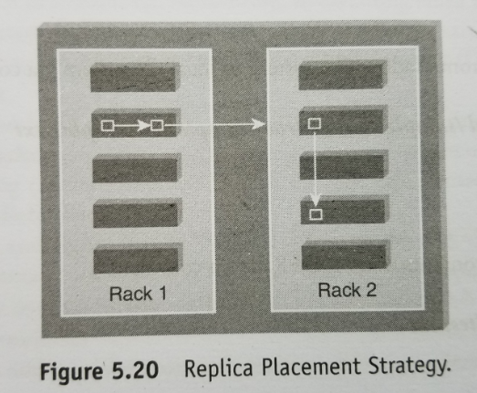

Slide 42
PROCESSING DATA WITH HADOOP
MapReduce programming helps to process massive amounts of data in parallel
Input data set splits into independent chunks
Map task
(key, value) pair
generates intermediate results
automatically shuffle and sorted by the framework
Reduce task-provides reduced output by combining the output of various mapers
Data Locality- performing map reduce tasks where the data is stored

Slide 43
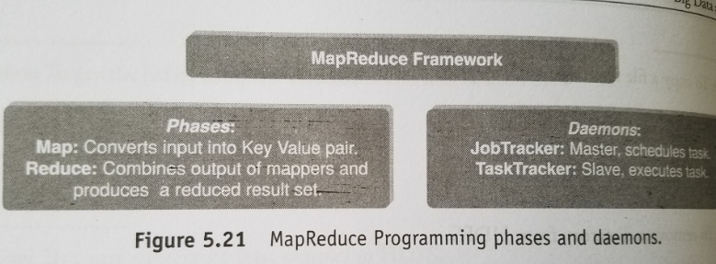

Slide 44
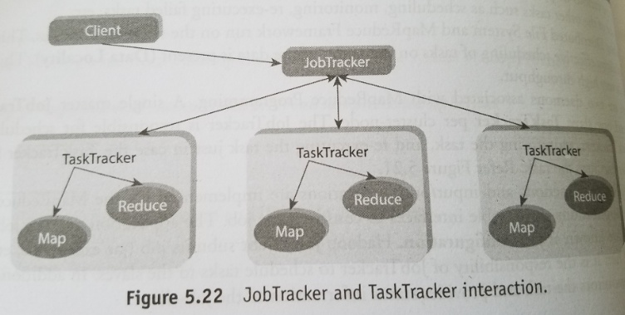

Slide 45
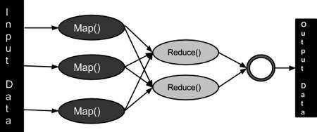

Slide 46
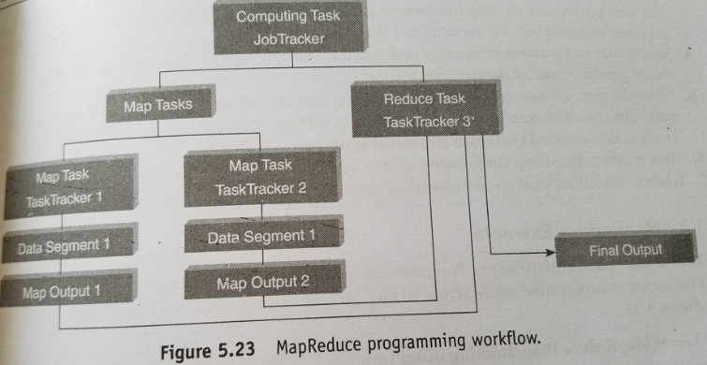
HOW DOES MAPREDUCE WORK?

Slide 47
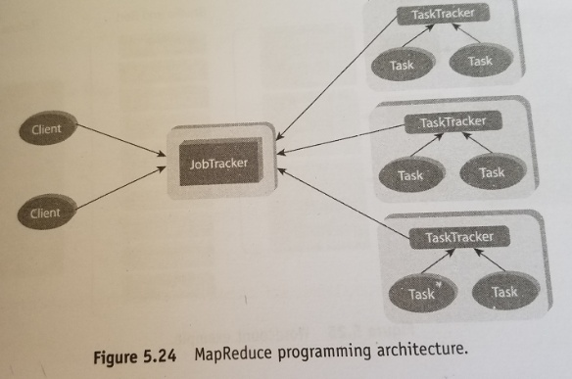

Slide 48
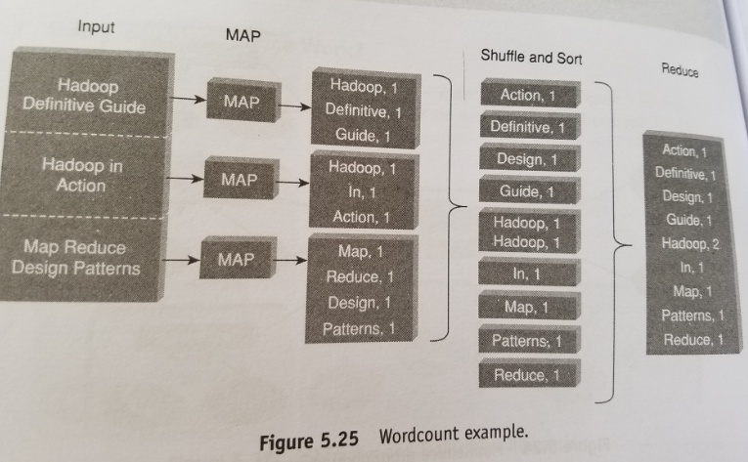
MAP REDUCE EXAMPLE

Slide 49
WORD COUNT MAP REDUCE PROGRAM USING JAVA
1.Driver class: specifies job configuration details
2.Mapper class: Map Function
3.Reducer class: Reduce Function

Slide 50
#!/usr/bin/env python """mapper.py"""
import sys
# input comes from STDIN (standard input) for line in sys.stdin:
# remove leading and trailing whitespace
line = line.strip()
# split the line into words
words = line.split()
# increase counters for word in words:
# write the results to STDOUT (standard output);
# what we output here will be the input for the
# Reduce step, i.e. the input for reducer.py #
# tab-delimited; the trivial word count is 1
print '%s\t%s' % (word, 1)

Slide 51
#!/usr/bin/env python """reducer.py"""
from operator import itemgetter
import sys
current_word = None
current_count = 0
word = None
# input comes from STDIN
for line in sys.stdin:
# remove leading and trailing whitespace
line = line.strip()
# parse the input we got from mapper.py
word, count = line.split('\t', 1)
# convert count (currently a string) to int
try: count = int(count) except ValueError:
# count was not a number, so silently
# ignore/discard this line continue
# this IF-switch only works because Hadoop sorts map output
# by key (here: word) before it is passed to the reducer
if current_word == word: current_count += count else: if current_word:
# write result to STDOUT print '%s\t%s' % (current_word, current_count) current_count = count current_word = word
# do not forget to output the last word if needed! if current_word == word: print '%s\t%s' % (current_word, current_count)

Slide 52
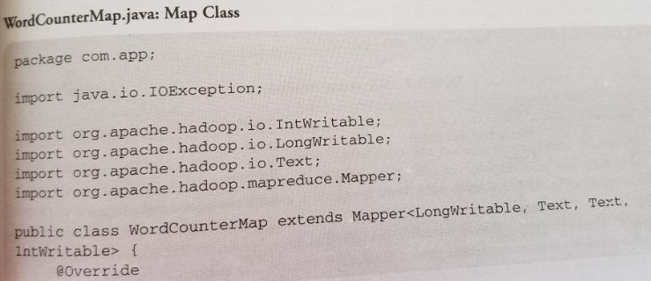
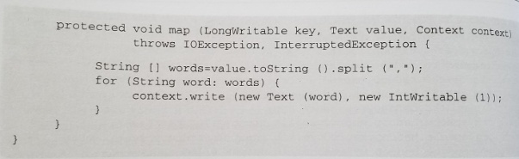

Slide 53
